Slide 1
Data Binding
By Shalini Gupta

Slide 2
Takeaway
What is component?
How to render a component?
How to create a new component?

Slide 3
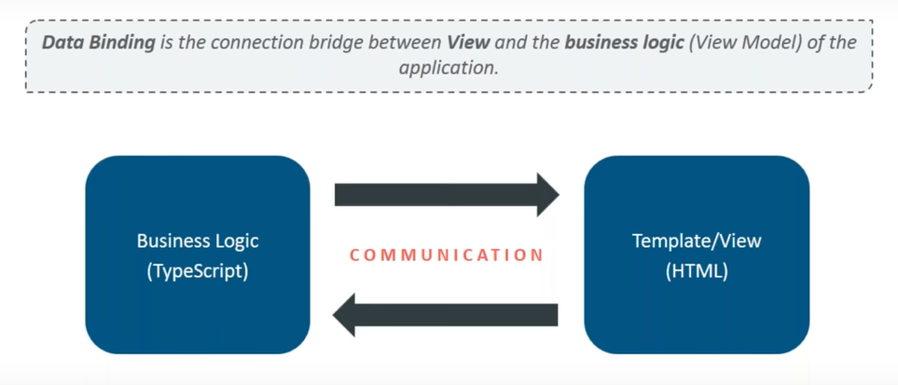
What is Data Binding?

Slide 4
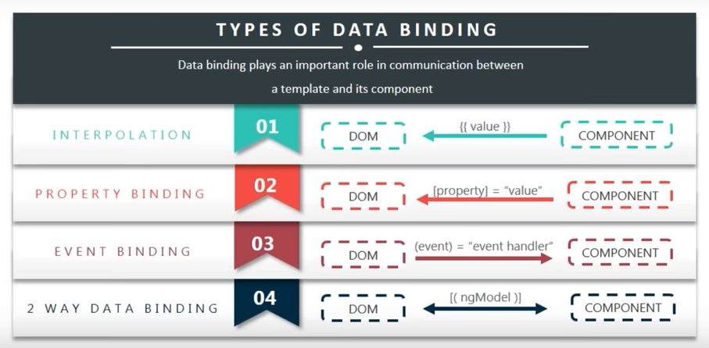
Types of Data Binding

Slide 5
Reference Links

Slide 6
Thank you!!

